Slide 1
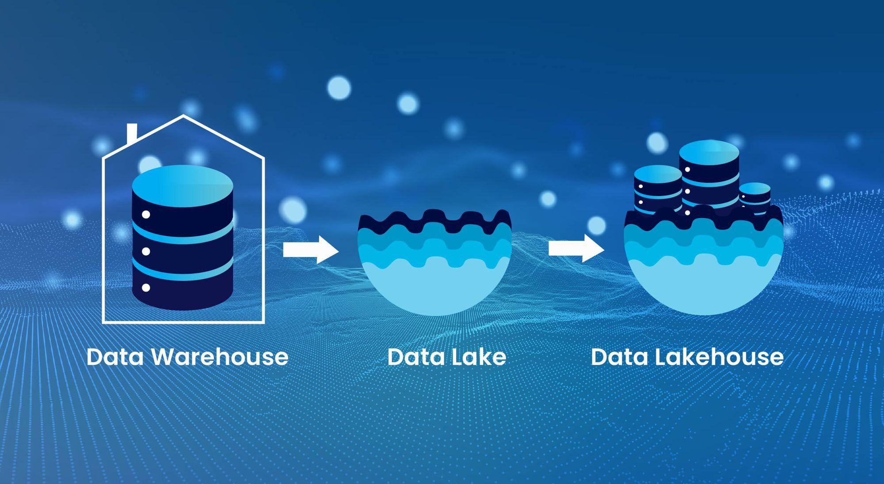
Data Lakehouse Modernization
Aanandhene M Data Engineer aanandhene26@gmail.com

Slide 2
Data Lakehouse Modernization
Project Overview:
Why this project?
Designed and implemented a modern Lakehouse architecture to handle:
Real-time streaming data
Scheduled batch workloads
Schema evolution without pipeline failures
Low-latency analytics for BI & applications

Slide 3
Business Problem:
Challenges in Legacy Systems
Multiple source databases (SQL & NoSQL)
No real-time visibility into data
Schema changes break ETL jobs
Batch-only analytics with high latency
Hard to scale and maintain
Tech Stack
Sources → Kafka → Flink → Apache Doris → BI / APIs
Metadata & Schema → MinIO
Batch Orchestration → Airflow

Slide 4
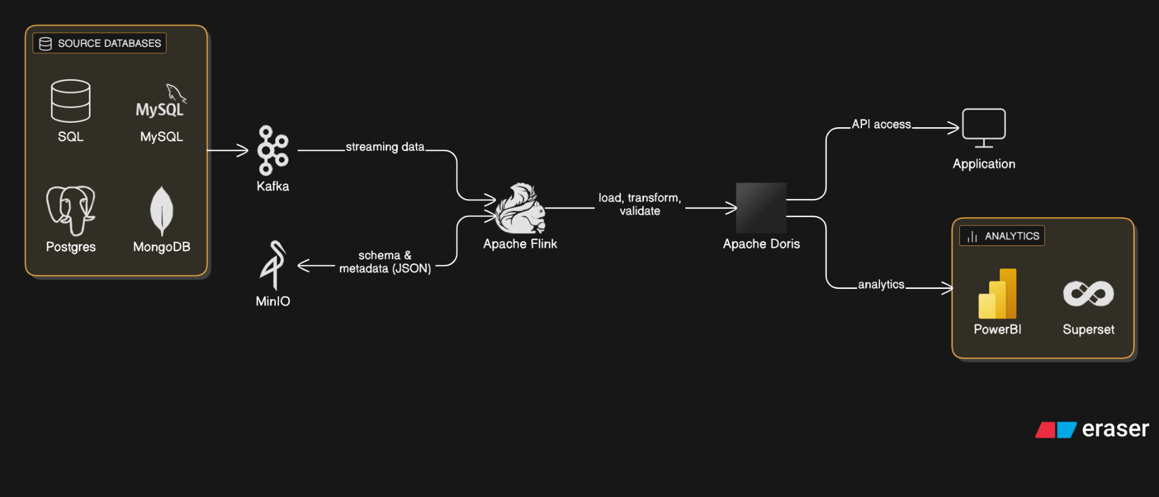
Data Lakehouse Architecture

Slide 5
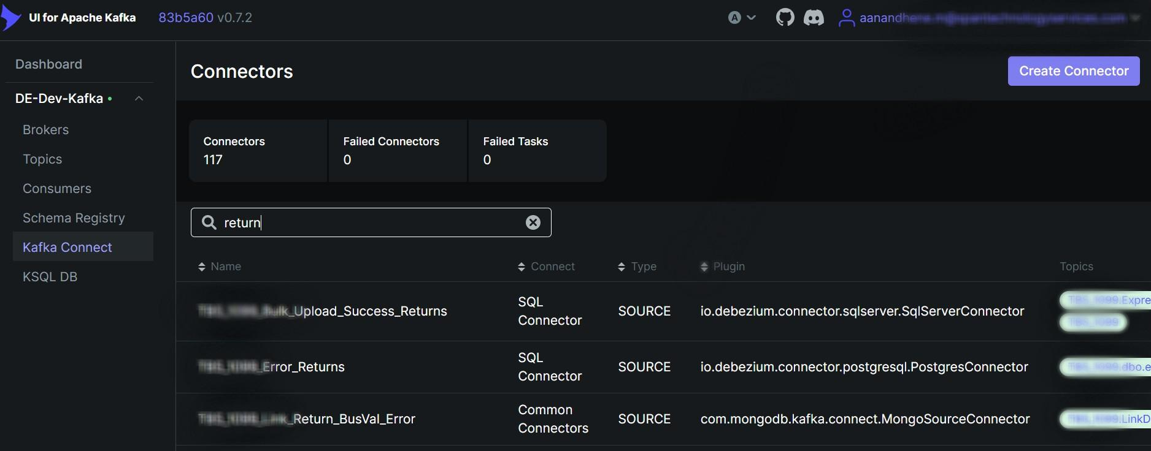
Source (SQL,MySQL,Postgres,MongoDB) -> Apache Kafka

Slide 6
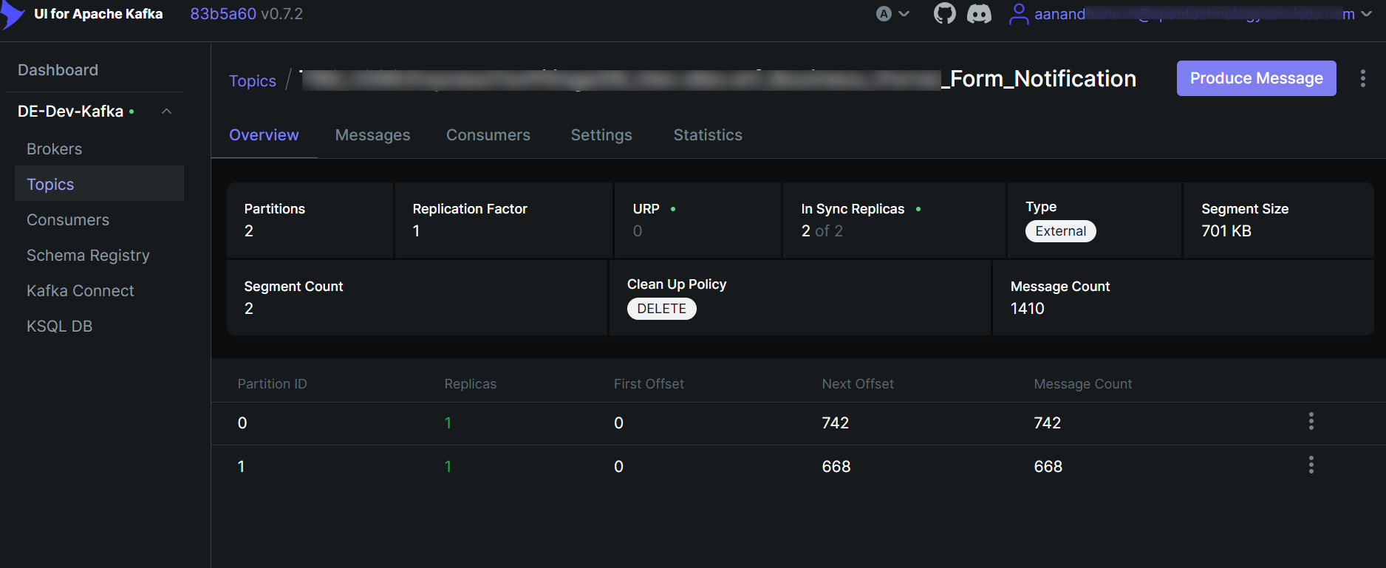
Handling Partition in Kafka Topic

Slide 7
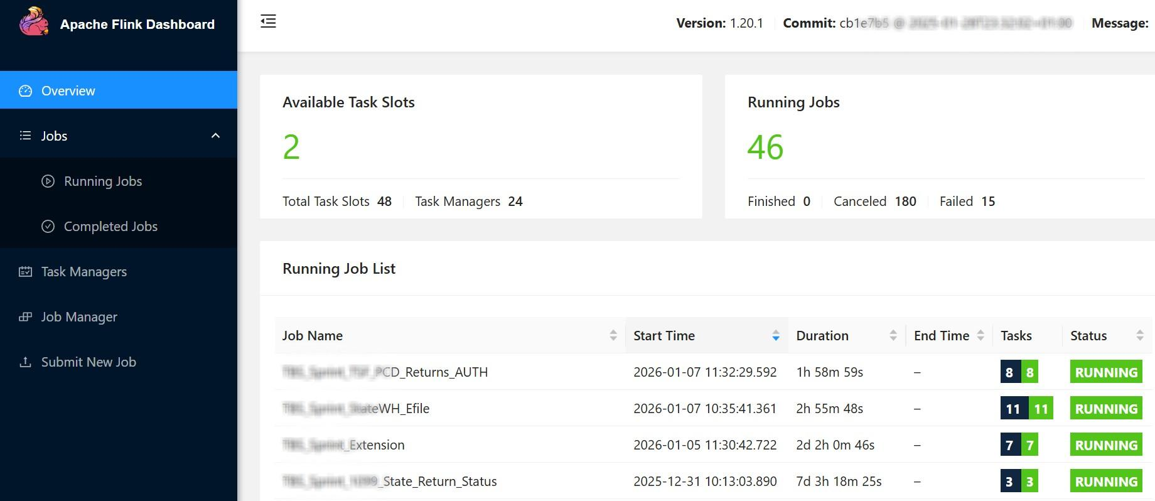
Migration through Apache Flink

Slide 8
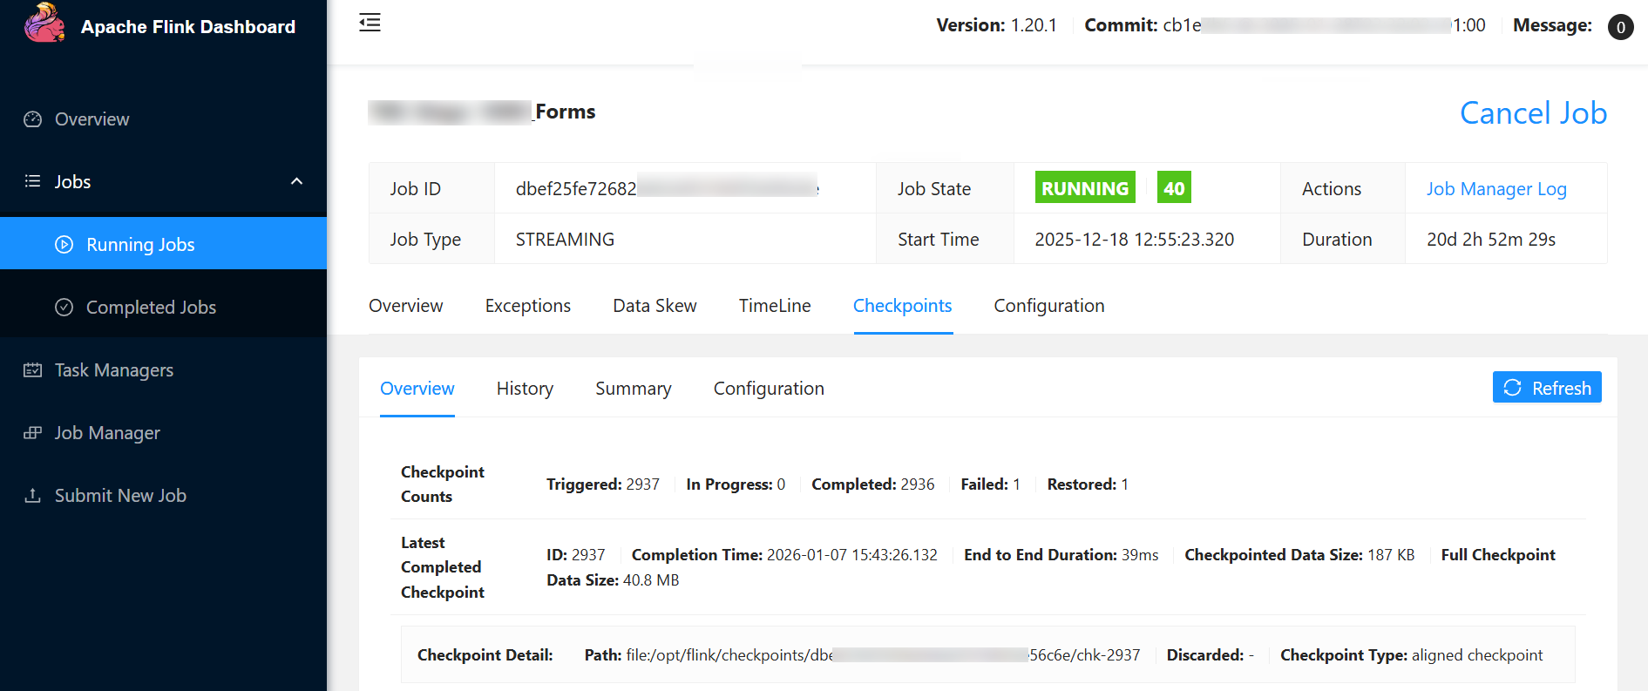
Handling Checkpoints in Flink

Slide 9
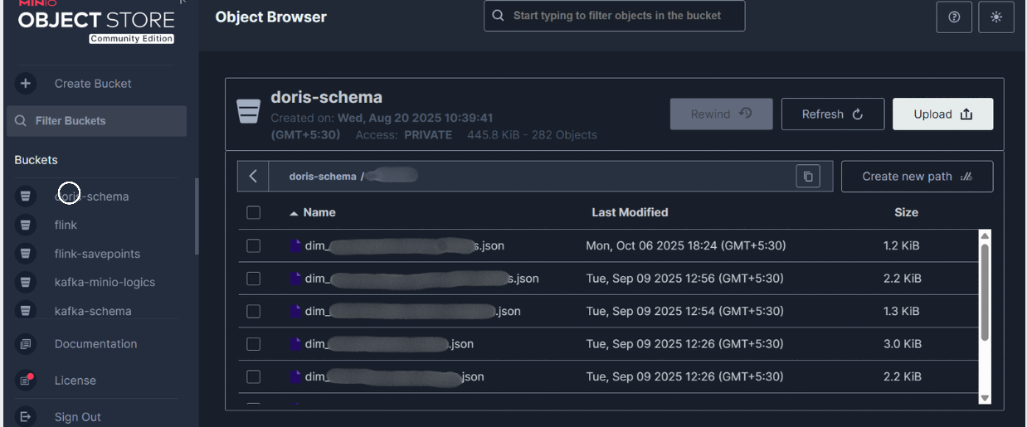
Storing Schema and Metadata in Minio

Slide 10
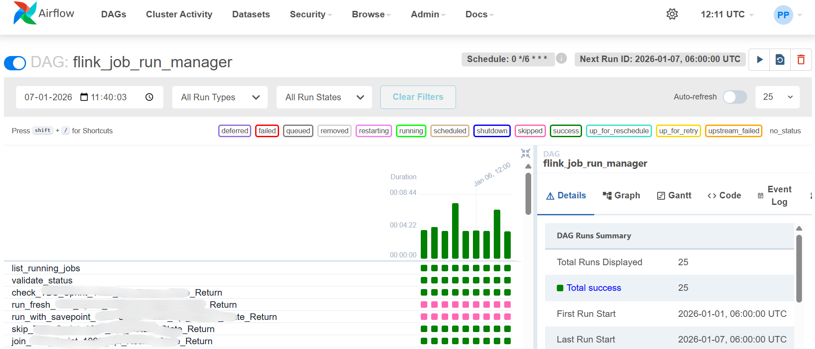
DAG-based orchestration - Automation of Flink Jobs

Slide 11
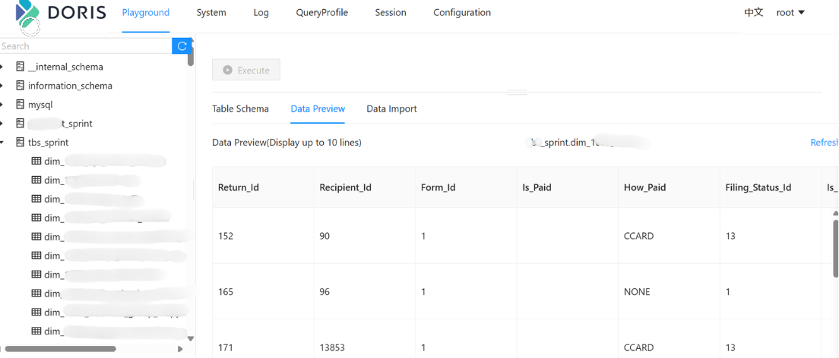
Fact and Dimensional tables in Doris

Slide 12
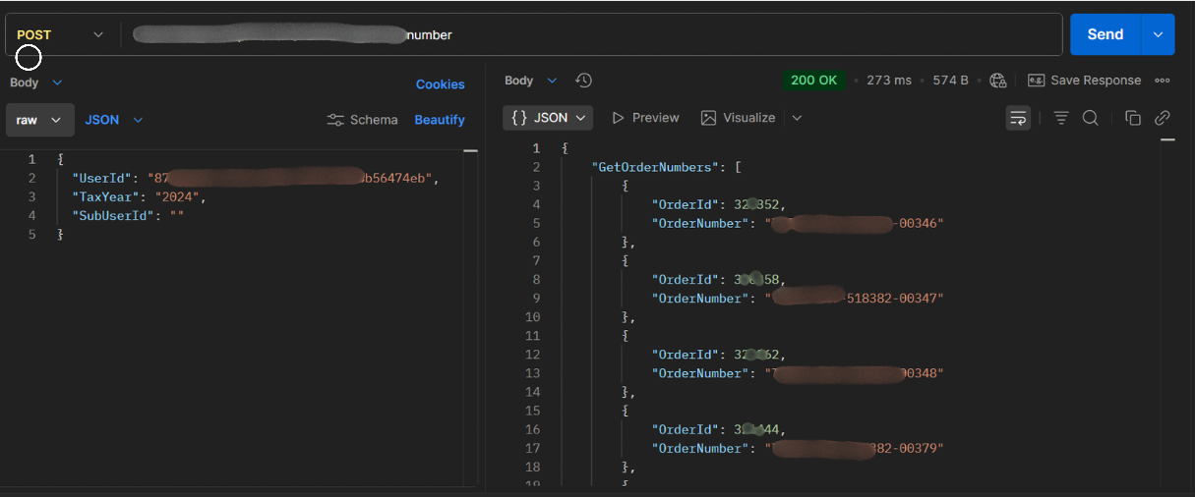
Endpoints for the Application

